Slide 1
Barack & Michelle Obama Academy
GO TEAM MEETING
Wednesday, January 24, 2024 @ 4:45 pm

Slide 2
AGENDA

Slide 3
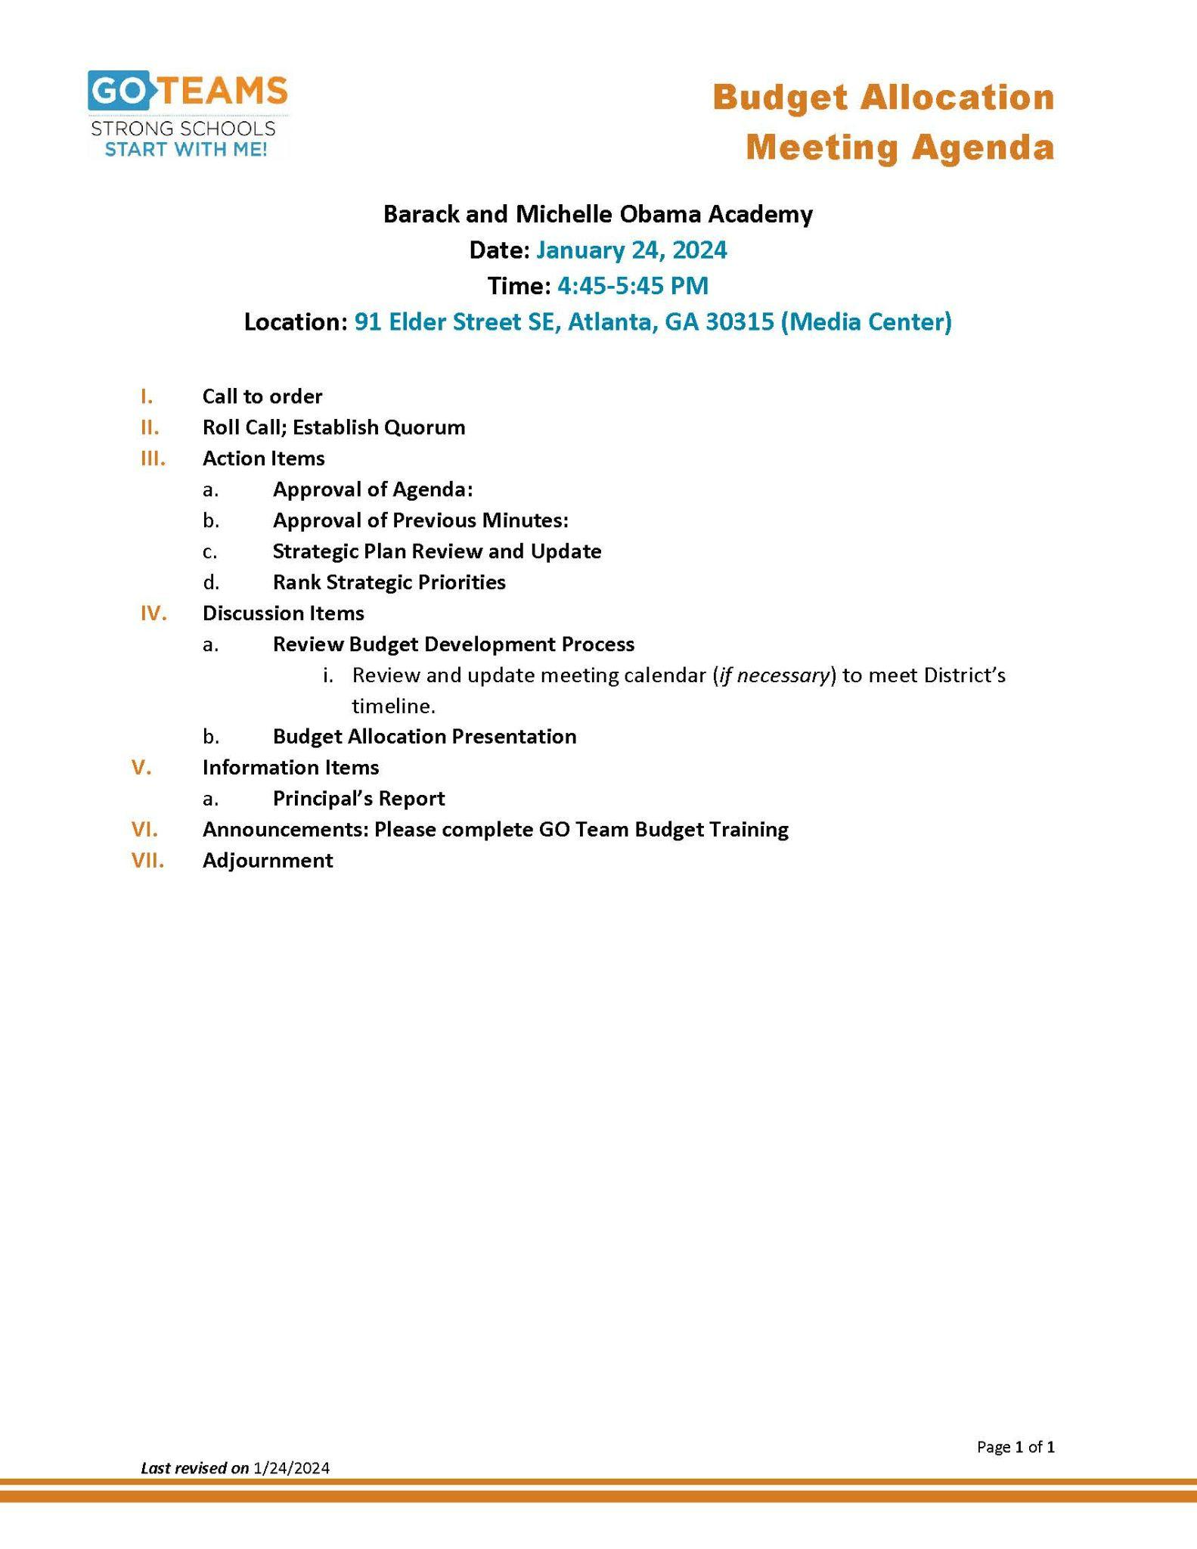

Slide 4
ACTION ITEMS

Slide 5
DISCUSSION ITEMS

Slide 6
INFORMATION ITEMS

Slide 8
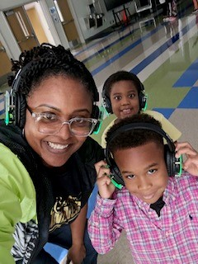
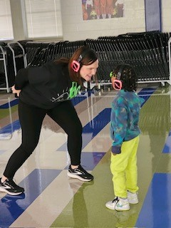
Updates
Academics
Literacy
Rollins
Writing
Math
IB Reset
21st Century CLCC Grant
The Arts
Holiday Program
MLK Parade
Jackson Cluster Night - Feb. 8th
Bolton Academy Black History Parade - March 1
St Patrick's Day Parade

Slide 9
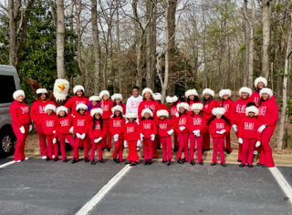
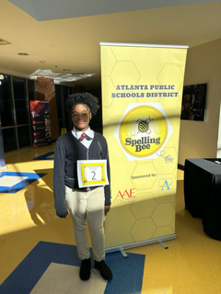
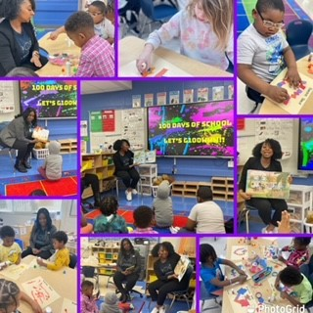
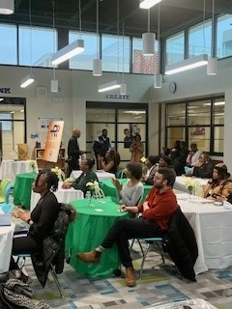
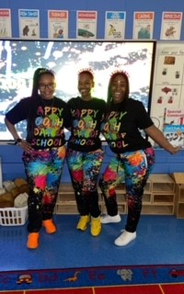
News to Share
January Attendance Challenge
Omni Readers Visit BaMO
Atlanta Watershed Community Magazine Share
100 Days of School
Empower U “Know Your Rights”
APS District Spelling Bee
Possible Site for Gift of Music Foundation

Slide 10
QUESTIONS

